Slide 1


Household Expenditure Analysis : Trends & Insights (2017-2021)
Analysing Spending Patterns Across Canadian Provinces and Income Groups
Anthony Aniemeke
March 2025

Slide 2
1
INTRODUCTION
Why Analyse Household Expenditures?
Understand spending behaviours across Canadian provinces and income groups
Identify key trends to inform policy and economic decisions
Data Source
Statistics Canada (2017-2021)
Household expenditure data across provinces & income quintiles
Goal of the Study:
Explore how spending varies by region and income level
Provide insights for policymakers, businesses, and newcomers

Slide 3
2
DATA OVERVIEW
Source: Statistics Canada
Variables:
Geography: Province
Expenditure: Average annual per household
Year: 2017-2021
Income Quintile: Lowest to Highest
Spending Categories: Shelter, Food, Transport, etc.

Slide 4
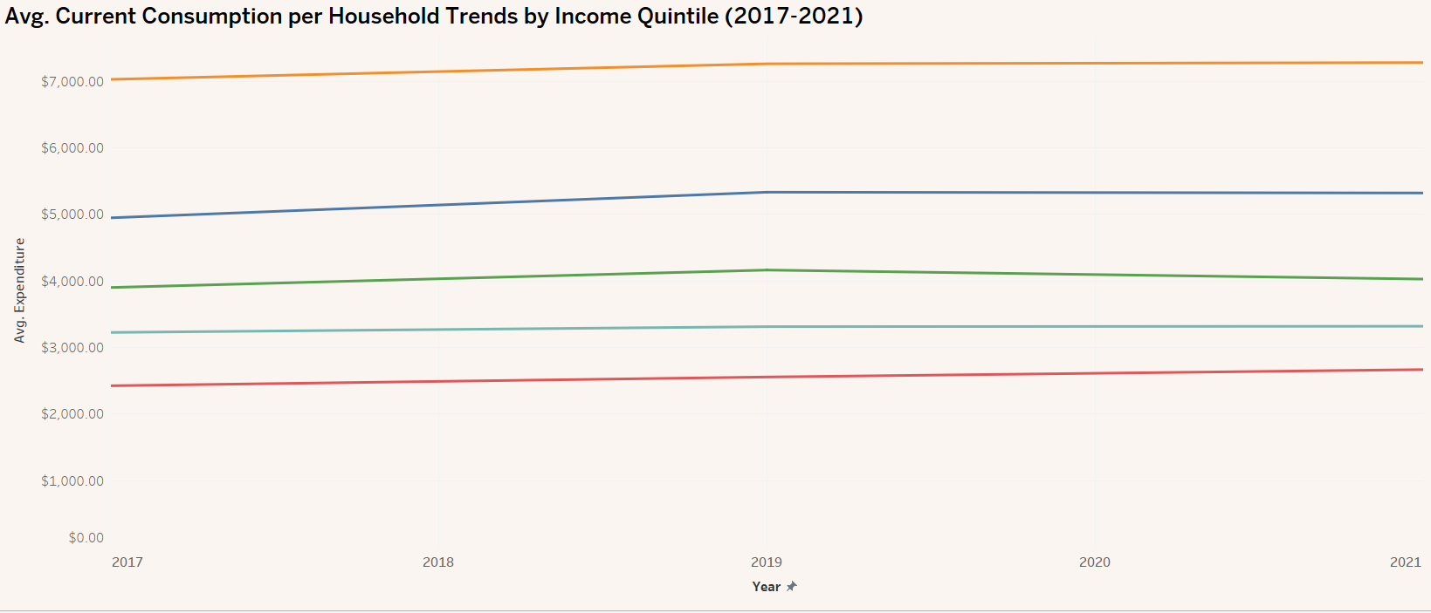
3
SPENDING TRENDS OVER TIME
Insight:
Higher-income households consistently spend more, with the highest quintile averaging over $7,000 per year and the lowest quintile spending around $2,500.
Spending increased slightly from 2017 to 2019 but plateaued post-2020, likely due to economic factors such as COVID-19 and inflation.

Slide 5
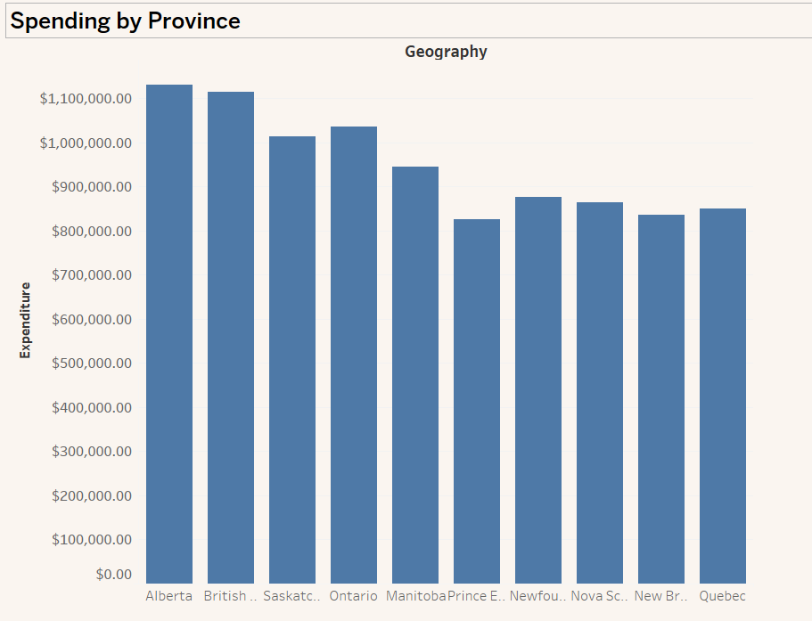
4
SPENDING BY PROVINCE
Insight:
Ontario, Alberta, and British Columbia have the highest household expenditures, reflecting regional cost of living differences.
Prince Edward Island and New Brunswick have the lowest expenditures, indicating more affordable living costs.

Slide 6
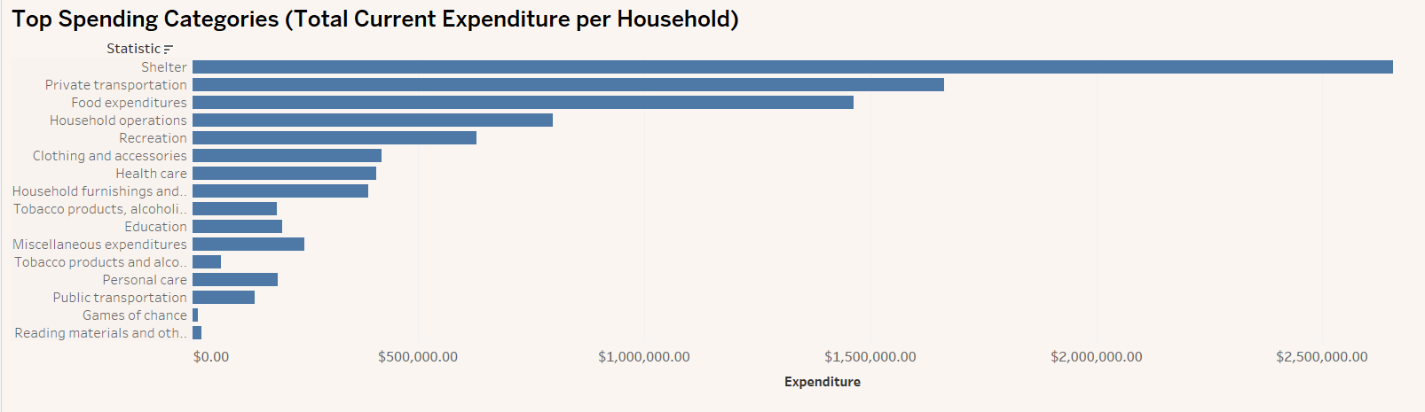
5
SPENDING BY CATEGORY
Insight:
Shelter is the largest expense, followed by transportation and food.
Education has the lowest spending, possibly due to subsidies or lower household investment.

Slide 7
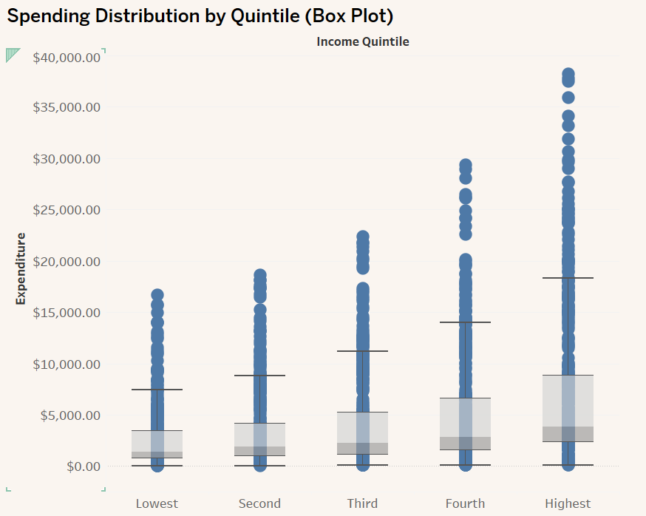
6
SPENDING DISTRIBUTION BY QUINTILE
Insight:
Higher-income groups show greater variation in spending, with extreme outliers indicating some households spend significantly more.
The lowest quintile has the least variation, suggesting tight budget constraints.

Slide 8
7
KEY TAKEAWAYS
Higher-income groups consistently outspend lower-income groups.
Shelter, transportation, and food constitute majority of household expenses.
Geographic differences significantly impact spending patterns.

Slide 9
8
RECOMMENDATIONS
For Policymakers
Provide targeted subsidies for essential expenses to support lower-income households.
Monitor post-pandemic spending shifts to address changes in consumer behaviour.
For Businesses
Focus on housing, transportation, and food sectors, tailoring products based on income levels.
For Newcomers & Students
Consider provinces with lower living costs, such as Prince Edward Island and New Brunswick, for affordability.
Budget strategically, focusing on essential categories like rent, transportation, and groceries.
Seek financial aid or subsidies available for students and newcomers in specific provinces.

Slide 10
9
FURTHER EXPLORATION
Interactive Dashboard: Explore the full analysis on Tableau Public
GitHub Repository: Access the complete project on GitHub

Slide 11
THANK YOU

